Slide 1
CSE 464 : Software Quality Assurance and Testing
Testing Object Oriented Applications Janaka Balasooriya

Slide 2
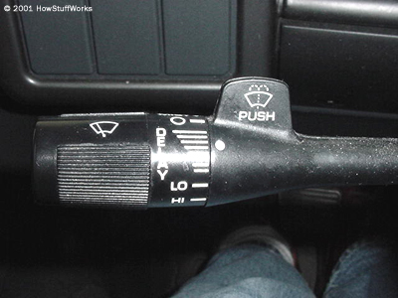
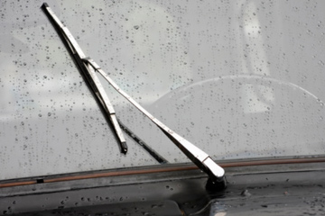
Windshield Wiper Example
auto.howstuffworks.com

Slide 3
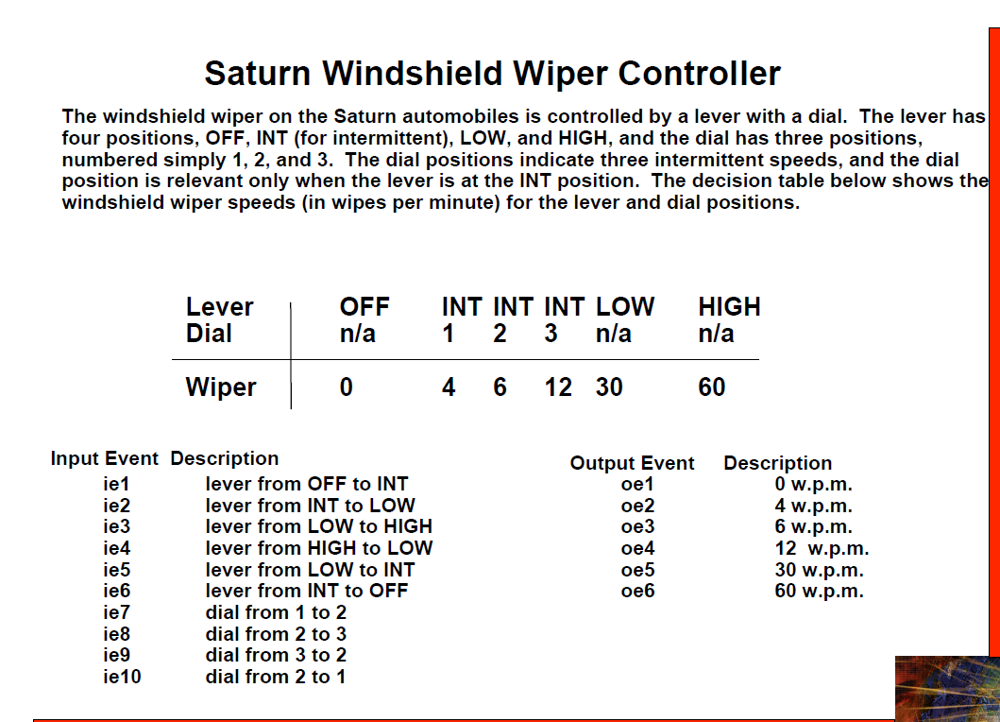

Slide 4
Testing the Windshield Wiper Application
Uisng JUnit
JUnit test cases that test get-set methods
JUnit test cases based on its usage – use case based
JUnit test cases based on state chart

Slide 5
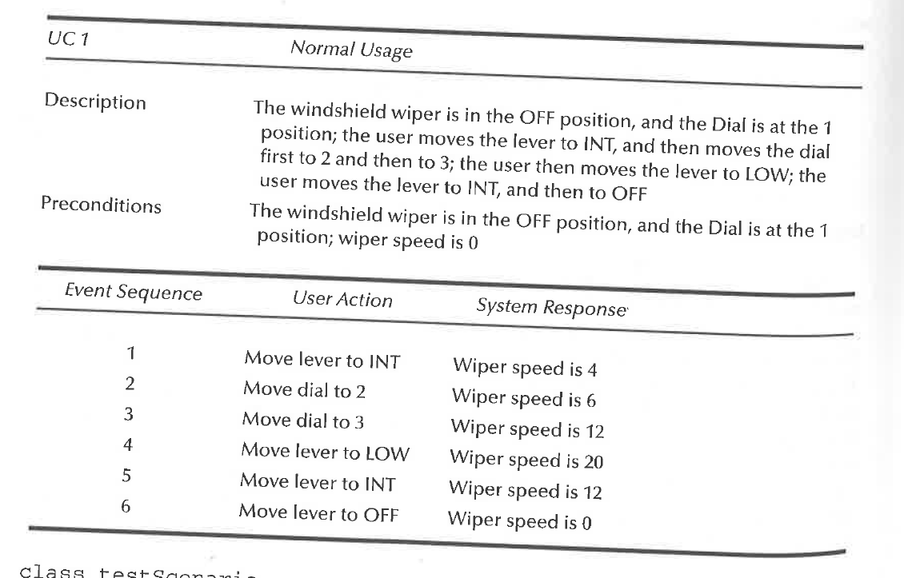
Windshield Wiper : Normal Usage (Use case)

Slide 6
Use-case based test cases - Demo

